Slide 1
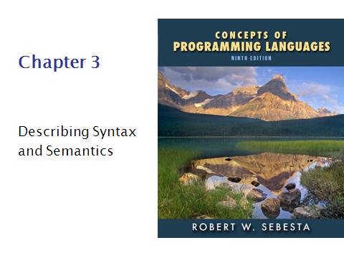

Slide 2
Outline
Introduction
The General Problem of Describing Syntax
Formal Methods of Describing Syntax
Attribute Grammars
Describing the Meanings of Programs: Dynamic Semantics

Slide 3
Introduction
Syntax - the form or structure of the expressions, statements, and program units
Semantics - the meaning of the expressions,
statements, and program units

Slide 4
Who must use language definition?
Other language designers
Implementers
Programmers (the users of the language)
A sentence is a string of characters over some
alphabet
A language is a set of sentences
A lexeme is the lowest level syntactic unit of a
language (e.g., *, sum, begin)
A token is a category of lexemes (e.g., identifier).

Slide 5
Formal approaches to describing syntax:
1. Recognizers - used in compilers
2. Generators - generate the sentences of
a language.

Slide 6
Context-Free Grammars
Developed by Noam Chomsky in the mid-1950s
Language generators, meant to describe the syntax of natural languages
Define a class of languages called context-free languages

Slide 7
Backus Normal Form (1959)
Invented by John Backus to describe Algol 58
BNF is equivalent to context-free grammars
A metalanguage is a language used to describe
another language.

Slide 8
BNF Continue..
In BNF, abstractions are used to represent
classes of syntactic structures--they act like syntactic variables (also called non-terminal symbols)e.g.
<while_stmt> -> while <logic_expr> do <stmt>
This is a rule; it describes the structure of a while
statement.

Slide 9
Grammar and Derivation
A rule has a left-hand side (LHS) and a right hand side (RHS), and consists of terminal and non-terminal symbols.
A grammar is a finite nonempty set of rules.
An abstraction (or non-terminal symbol) can have more than one RHS.
<stmt> -> <single_stmt>
| begin <stmt_list> end

Slide 10
Continue..
Syntactic lists are described in BNF using recursion
<ident_list> -> ident
| ident, <ident_list>
A derivation is a repeated application of rules,
starting with the start symbol and ending with a
sentence (all terminal symbols).

Slide 11
An example grammar:
<program> -> <stmts>
<stmts> -> <stmt> | <stmt> ; <stmts>
<stmt> -> <var> = <expr>
<var> -> a | b | c | d
<expr> -> <term> + <term> | <term> - <term>
<term> -> <var> | const

Slide 12
An example derivation:
program> => <stmts> => <stmt>
=> <var> = <expr> => a = <expr>
=> a = <term> + <term>
=> a = <var> + <term>
=> a = b + <term>
=> a = b + const

Slide 13
Grammar and Derivation Continue..
Every string of symbols in the derivation is a sentential form.
A sentence is a sentential form that has only
terminal symbols.
A leftmost derivation is one in which the leftmost
nonterminal in each sentential form is the one that
is expanded.
A derivation may be neither leftmost nor rightmost.

Slide 14
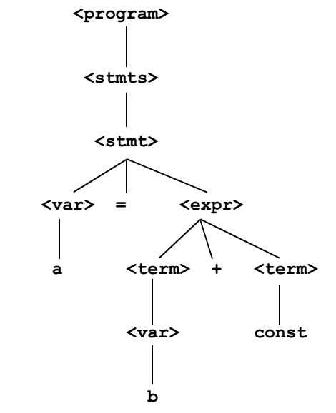
Parse Tree
A parse tree is a hierarchical representation of
a derivation.

Slide 15
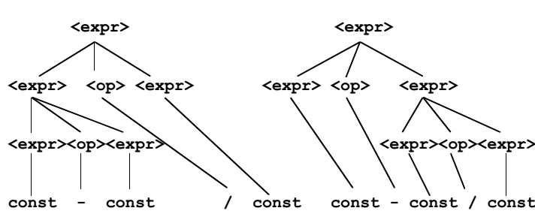
Ambiguity
A grammar is ambiguous iff it generates a sentential form that has two or more distinct parse trees.
An ambiguous expression grammar:
If we use the parse tree to indicate precedence
levels of the operators, we cannot have ambiguity.

Slide 16
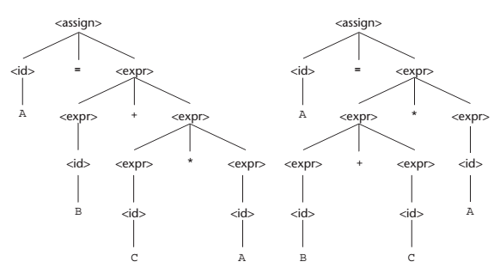
An other Example
Two distinct parse trees for the same sentence,
A = B + C * A

Slide 17
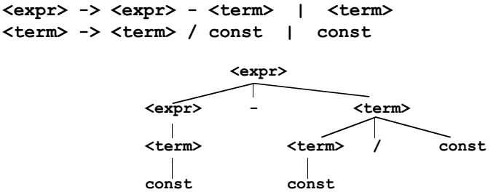
An unambiguous expression grammar:
<expr> => <expr> - <term> => <term> - <term>
=> const - <term>
=> const - <term> / const
=> const - const / const

Slide 18
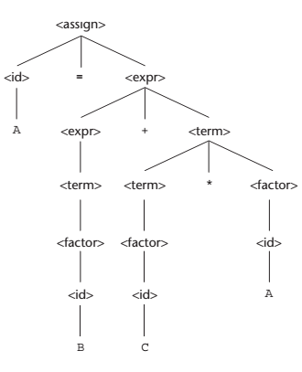
Example
<assign> =><id>= <expr>
=><id>= <expr>+ <term>
=><id>= <expr>+ <term> *<factor>
=><id>= <expr>+ <term> *<id>
=><id>= <expr>+ <term> * A
=><id>= <expr>+ <factor> * A
=><id>= <expr>+ <id> * A
=><id>= <expr>+ C * A
=><id>= <term>+ C * A
=><id>= <factor>+ C * A
=><id>= <id>+ C * A
=><id>= B + C * A
=> A = B + C * A

Slide 19
Recursive Descent Parsing
- Parsing is the process of tracing or constructing
a parse tree for a given input string.
- Parsers usually do not analyze lexemes; that is
done by a lexical analyzer, which is called by the
parser.
- A recursive descent parser traces out a parse
tree in top-down order; it is a top-down parser.
- Each nonterminal in the grammar has a
subprogram associated with it; the subprogram
parses all sentential forms that the nonterminal
can generate.

Slide 20
Continue…
- The recursive descent parsing subprograms are
built directly from the grammar rules.
- Recursive descent parsers, like other top-down
parsers, cannot be built from left-recursive
grammars.
Example: For the grammar:
<term> -> <factor> {(* | /) <factor>}

Slide 21
Continue…
We could use the following recursive descent
parsing subprogram (this one is written in C)
void term() {
factor(); /* parse the first factor*/
while (next_token == ast_code ||
next_token == slash_code) {
lexical(); /* get next token */
factor(); /* parse the next factor */
}
}

Slide 22
Static semantics
The static semantics of a language is only indirectly related to the meaning of programs during execution; rather, it has to do with the legal forms of programs (syntax rather than semantics).
Categories:
1. Context-free but unmanageable (e.g. type
checking).
2. Noncontext-free (e.g. variables must be
declared before they are used).

Slide 23
Attribute Grammars (AGs) (Knuth, 1968)
- Cfgs cannot describe all of the syntax of programming languages.
- Additions to cfgs to carry some semantic info
along through parse trees.
Primary value of AGs:
1. Static semantics specification
2. Compiler design(static semantics checking)

Slide 24
Continue..
Def: An attribute grammar is a cfg
with the following additions:
1. For each grammar symbol x there is a set A(x) of attribute values.
2. Each rule has a set of functions that define
certain attributes of the nonterminals in the rule.
3. Each rule has a (possibly empty) set of
predicates to check for attribute consistency.

Slide 25
Dynamic Semantics
No single widely acceptable notation or formalism for describing semantics.
I. Operational Semantics
- Describe the meaning of a program by executing
its statements on a machine, either simulated or
actual. The change in the state of the machine
(memory, registers, etc.) defines the meaning of
the statement

Slide 26
Continue..
- To use operational semantics for a high-level
language, a virtual machine in needed
- A hardware pure interpreter would be too expensive
A software pure interpreter also has problems:
1. The detailed characteristics of the particular
computer would make actions difficult to
understand.
2. Such a semantic definition would be machine- dependent.

Slide 27
A better alternative:
A complete computer simulation
The process:
1. Build a translator (translates source code to the machine code of an idealized computer).
2. Build a simulator for the idealized computer.
Evaluation of operational semantics:
- Good if used informally
- Extremely complex if used formally

Slide 28
Axiomatic Semantics
- Based on formal logic (first order predicate calculus).
- Original purpose: formal program verification.
- Approach: Define axioms or inference rules for
each statement type in the language
(to allow transformations of expressions
to other expressions).

Slide 29
Continue..
- The expressions are called assertions or Predicates.
- An assertion before a statement (a precondition)
states the relationships and constraints among
variables that are true at that point in execution.
- An assertion following a statement is a post-condition.
- A weakest precondition is the least restrictive
precondition that will guarantee the postcondition

Slide 30
An example: a := b + 1 {a > 1}
One possible precondition: {b > 10}
Weakest precondition: {b > 0}
Let S1 and S2 be adjacent program statements. If S1 and S2 have the following pre- and postconditions.
{P1} S1 {P2}
{P2} S2 {P3}
The inference rule for such a two-statement sequence is
{P1} S1 {P2}, {P2} S2 {P3}
{P1} S1, S2 {P3}

Slide 31
An inference rule for logical pretest loop
For the loop construct:
{P} while B do S end {Q}
the inference rule is:
(I and B) S {I}
{I} while B do S {I and (not B)}
where I is the loop invariant. This seems simple, but it is not. The complexity lies in finding an appropriate loop invariant.

Slide 32
Characteristics of the loop invariant
I must meet the following conditions:
P => I (the loop invariant must be true initially)
{I} B {I} (evaluation of the Boolean must not
change the validity of I)
3. {I and B} S {I} (I is not changed by executing
the body of the loop)
4. (I and (not B)) => Q (if I is true and B is false,
Q is implied)
5. The loop terminates (this can be difficult to
prove)

Slide 33
Characteristics of the loop invariant
The loop invariant I is a weakened version of the loop postcondition, and it is also a precondition.
I must be weak enough to be satisfied prior to the beginning of the loop, but when combined with the loop exit condition, it must be strong enough to force the truth of the postcondition.

Slide 34
Evaluation of axiomatic semantics
Developing axioms or inference rules for all of the statements in a language is difficult.
It is a good tool for correctness proofs, and an excellent framework for reasoning about programs, but it is not as useful for language users and compiler writers.

Slide 35
Denotational Semantics
Based on recursive function theory.
The most abstract semantics description method.
The process of building a denotational specification for a language:
Define a mathematical object for each language entity.
Define a function that maps instances of the language entities onto instances of the corres-ponding mathematical objects.

Slide 36
Denotational Semantics
The meaning of language constructs are defined by only the values of the program's variables.
The state of a program is the values of all its current variables
s = {<i1, v1>, <i2, v2>, …, <in, vn>}
The syntax of such binary numbers can be described by the following grammar rules:
<bin_num> → '0‘‚
| '1'
|<bin_num> '0'
|<bin_num> '1'

Slide 37
Denotational Semantics
Decimal Numbers
<dec_num> → 0 | 1 | 2 | 3 | 4 | 5 | 6 | 7 | 8 | 9
| <dec_num> (0 | 1 | 2 | 3 | 4 |
5 | 6 | 7 | 8 | 9)
The denotational mappings for these syntax rules are:
Mdec('0') =0, Mdec('1') =1, Mdec('2') =2, . . ., M
dec('9') = 9
Mdec(<dec_num> '0') =10 *Mdec(<dec_num>)
Mdec(<dec_num> '1') =10 *Mdec(<dec_num>) + 1
. . .
Mdec(<dec_num> '9') =10 *Mdec(<dec_num>) + 9

Slide 38
Expressions
Expressions are fundamental to most programming languages. We assume here that expressions have no side effects.
Following is the BNF description of these expressions:
<expr> →<dec_num> |<var> |<binary_expr>
<binary_expr> →<left_expr> <operator> <right_expr>
<left_expr> →<dec_num> |<var>
<right_expr> →<dec_num> |<var>
<operator> → + | *
The only error we consider in expressions is a variable having an undefined value.

Slide 39
Expressions
Me(<expr>, s) ∆=case <expr> of
<dec_num> =>Mdec(<dec_num>, s)
<var> => if VARMAP(<var>, s) = undef
then error
else VARMAP(<var>, s)
<binary_expr> =>
if(Me(<binary_expr>.<left_expr>,s) == undef OR
Me(<binary_expr>.<right_expr>, s) == undef)
then error
else if (<binary_expr>.<operator> == '+')
then Me(<binary_expr>.<left_expr>, s) +
Me(<binary_expr>.<right_expr>, s)
else Me(<binary_expr>.<left_expr>, s) *
Me(<binary_expr>.<right_expr>, s)

Slide 40
Assignment Statements
An assignment statement is an expression evaluation plus the setting of the target variable to the expression’s value.
This function can be described with the following:
Ma(x := E, s) ∆=if Me(E, s) = error
then error
else s’ = {<i1’,v1’>,<i2’,v2’>,...,<in’,vn’>},where
for j = 1, 2, ..., n,
vj’ = VARMAP(ij, s) if ij <> x
= Me(E, s) if ij = x
Note that the comparison in the third last line above, ij ==x, is of names, not values.

Slide 41
Evaluation of denotational semantics
Can be used to prove the correctness of programs.
Provides a rigorous way to think about programs
Can be an aid to language design
Has been used in compiler generation systems.

