Slide 1
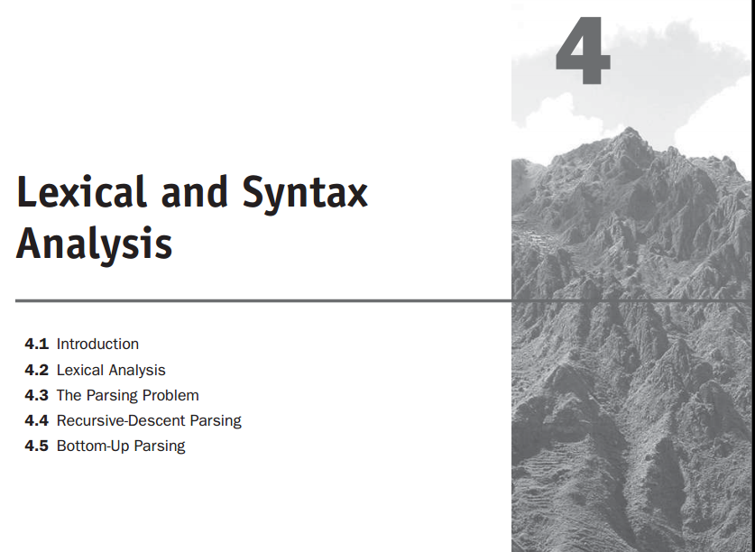

Slide 2
Introduction
The compilation approach uses a program called a compiler, which translates programs written in a high-level programming language into machine code. Compilation is typically used to implement programming languages that are used for large applications, often written in languages such as C++ and COBOL.

Slide 3
Introduction
Pure interpretation systems perform no translation; rather, programs are interpreted in their original form by a software interpreter. Pure interpretation is usually used for smaller systems in which execution efficiency is not critical, such as scripts embedded in HTML documents, written in languages such as JavaScript.

Slide 4
Introduction
Hybrid implementation systems translate programs written in high-level languages into intermediate forms, which are interpreted.
Syntax analyzers, or parsers, are nearly always based on a formal description of the syntax of programs.
The lexical analyzer deals with small-scale language constructs, such as names and numeric literals.
The syntax analyzer deals with the large-scale constructs, such as expressions, statements, and program units.

Slide 5
why lexical analysis is separated from syntax analysis?
Simplicity—Techniques for lexical analysis are less complex than those required for syntax analysis, so the lexical-analysis process can be simpler if it is separate. Also, removing the low-level details of lexical analysis from the syntax analyzer makes the syntax analyzer both smaller and less complex.

Slide 6
why lexical analysis is separated from syntax analysis?
Efficiency—Although it pays to optimize the lexical analyzer, because lexical analysis requires a significant portion of total compilation time, it is not fruitful to optimize the syntax analyzer. Separation facilitates this selective optimization.
Portability—Because the lexical analyzer reads input program files and often includes buffering of that input, it is somewhat platform dependent.

Slide 7
lexical analysis
A lexical analyzer is essentially a pattern matcher. A pattern matcher attempts to find a substring of a given string of characters that matches a given character pattern.
A lexical analyzer serves as the front end of a syntax analyzer. Technically, lexical analysis is a part of syntax analysis.
The lexical analyzer collects characters into logical groupings and assigns internal codes to the groupings according to their structure.

Slide 8
lexical analysis
logical groupings of characters are named lexemes, and the internal codes for categories of these groupings are named tokens.
Lexemes are recognized by matching the input character string against character string patterns.
Tokens are usually represented as integer values, for the sake of readability of lexical and syntax analyzers.

Slide 9
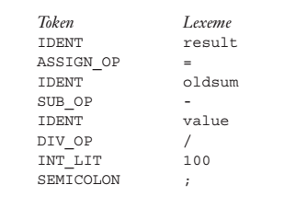
lexical analysis
Consider the following example of an assignment statement:
result = oldsum – value / 100;
Following are the tokens and lexemes of this statement:

Slide 10
lexical analysis
Lexical analyzers extract lexemes from a given input string and produce the corresponding tokens.
The only view of the input program seen by the syntax analyzer is the output of the lexical analyzer, one token at a time.
The lexical-analysis process includes skipping comments and white space outside lexemes, as they are not relevant to the meaning of the program.
lexical analyzers detect syntactic errors in tokens.

Slide 11
lexical analysis
There are three approaches to building a lexical analyzer:
Write a formal description of the token patterns of the language using a descriptive language related to regular expressions. These descriptions are used as input to a software tool that automatically generates a lexical analyzer.
Design a state transition diagram that describes the token patterns of the language and write a program that implements the diagram.

Slide 12
lexical analysis
3. Design a state transition diagram that describes the token patterns of the language and hand-construct a table-driven implementation of the state diagram.
State diagrams of the form used for lexical analyzers are representations of a class of mathematical machines called finite automata.
Finite automata can be designed to recognize members of a class of languages called regular languages.
The tokens of a programming language are a regular language, and a lexical analyzer is a finite automaton.

Slide 13
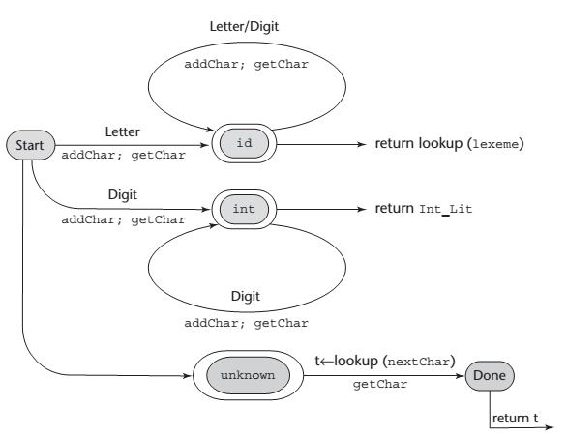
lexical analysis
A state diagram to recognize names, parentheses, and arithmetic operators:

Slide 14
The Parsing Problem
The part of the process of analyzing syntax that is referred to as syntax analysis is often called parsing.
Introduction to Parsing: Parsers for programming languages construct parse trees for given programs. There are two distinct goals of syntax analysis: First, the syntax analyzer must check the input program to determine whether it is syntactically correct. When an error is found, the analyzer must produce a diagnostic message and recover.

Slide 15
The Parsing Problem
The second goal of syntax analysis is to produce a complete parse tree, or at least trace the structure of the complete parse tree, for syntactically correct input. The parse tree (or its trace) is used as the basis for translation.
Parsers are categorized according to the direction in which they build parse trees. The two broad classes of parsers are top-down, in which the tree is built from the root downward to the leaves, and bottom-up, in which the parse tree is built from the leaves upward to the root.

Slide 16
Notational conventions for grammar symbols and strings
Terminal symbols—lowercase letters at the beginning of the alphabet (a, b, . . .).
Nonterminal symbols—uppercase letters at the beginning of the alpha- bet (A, B, . . .).
Terminals or nonterminals—uppercase letters at the end of the alphabet (W, X, Y, Z).
Strings of terminals—lowercase letters at the end of the alphabet (w, x, y, z).
Mixed strings (terminals and/or nonterminals)—lowercase Greek letters (α,β,ɣ) .

Slide 17
Top-down Parser
A top-down parser traces or builds a parse tree in preorder. A preorder traversal of a parse tree begins with the root. Each node is visited before its branches are followed. Branches from a particular node are followed in left-to-right order. This corresponds to a leftmost derivation.
For example, if the current sentential form is
xAα
and the A-rules are A →bB, A →cBb, and A →a, a top-down parser must choose among these three rules to get the next sentential form, which could be xbBα, xcBbα, or xaα. This is the parsing decision problem for top-down parsers.

Slide 18
Bottom –Up Parser
A bottom-up parser constructs a parse tree by beginning at the leaves and progressing toward the root. This parse order corresponds to the reverse of a rightmost derivation.
In terms of the derivation, a bottom-up parser can be described as follows: Given a right sentential form α,2 the parser must determine what substring of α is the RHS of the rule in the grammar that must be reduced to its LHS to produce the previous sentential form in the rightmost derivation.

Slide 19
Consider the following grammar and derivation:
S→aAc
A→aA │b
S =>aAc =>aaAc =>aabc

Slide 20
The LL Grammar Class
One simple grammar characteristic that causes a catastrophic problem for LL parsers is left recursion. For example, consider the following rule:
A→A+B
A recursive-descent parser subprogram for A immediately calls itself to parse the first symbol in its RHS. That activation of the A parser subprogram then immediately calls itself again, and again, and so forth

Slide 21
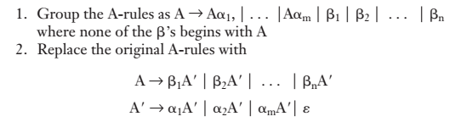
The LL Grammar Class
The left recursion in the rule A→A+B is called direct left recursion, because it occurs in one rule. Direct left recursion can be eliminated from a grammar by the following process:
For each nonterminal, A,

Slide 22
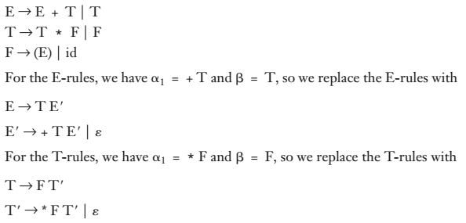
Consider the following example grammar and the application of the above process:

Slide 23
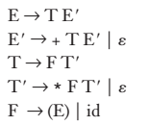
Because there is no left recursion in the F-rules, they remain the same, so the complete replace-ment grammar is
This grammar generates the same language as the original grammar but is not left recursive.

Slide 24
Recursive-Descent Parsing
The Recursive-Descent Parsing Process:
A recursive-descent parser is so named because it consists of a collection of subprograms, many of which are recursive, and it produces a parse tree in top-down order.
A recursive-descent parser has a subprogram for each nonterminal in its associated grammar. The responsibility of the subprogram associated with a particular nonterminal is as follows:

Slide 25
Recursive-Descent Parsing
When given an input string, it traces out the parse tree that can be rooted at that nonterminal and whose leaves match the input string. In effect, a recursive-descent parsing subprogram is a parser for the language (set of strings) that is generated by its associated nonterminal.
<expr> →<term> {(+| -) <term>}
<term> →<factor> {(*| /) <factor>}
<factor> →id | int_constant | (<expr> )

Slide 26
The Parsing Problem for Bottom-Up Parsers
Consider the following grammar for arithmetic expressions:
E →E +T | T
T →T *F | F
F → (E)| id

Slide 27
The following rightmost derivation illustrates this grammar:
E =>E +T
=>E +T *F
=>E +T *id
=>E +F *id
=>E +id *id
=>T +id *id
=>F +id *id
=>id +id *id
The underlined part of each sentential form in this derivation is the RHS that is rewritten as its corres-ponding LHS to get the previous sentential form.

Slide 28
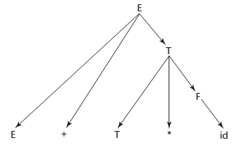
A parse tree for: E+T *id

Slide 29
Shift-Reduce Algorithms
Bottom-up parsers are often called shift-reduce algorithms, because shift and reduce are the two most common actions they specify. An integral part of every bottom-up parser is a stack.
Every parser for a programming language is a pushdown automaton(PDA), because a PDA is a recognizer for a context-free language.

Slide 30
With a PDA, the input string is examined, one symbol at a time, left to right. The input is treated very much as if it were stored in another stack, because the PDA never sees more than the leftmost symbol of the input.
LR parser:
LR parsers use a relatively small program and a parsing table that is built for a specific programming language. There are three advantages to LR parsers:

Slide 31
1. They can be built for all programming languages.
They can detect syntax errors as soon as it is possible in a left-to-right scan.
The LR class of grammars is a proper superset of the class parsable by LL parsers (for example, many left recursive grammars are LR, but none are LL).
The only disadvantage of LR parsing is that it is difficult to produce by hand the parsing table for a given grammar for a complete programming language.

