Slide 1
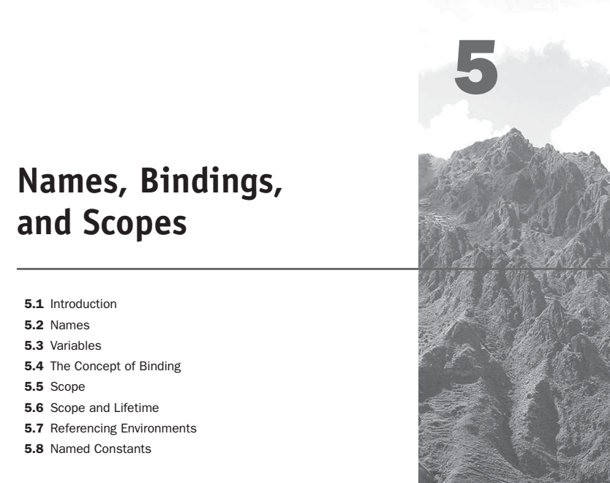

Slide 2
Introduction
A variable can be characterized by a collection of properties, or attributes, the most important of which is type, a fundamental concept in programming languages.
Functional programming languages allow expressions to be named. These named expressions appear like assignments to variable names in imperative languages, but are fundamentally different in that they cannot be changed.
Pure functional languages do not have variables that are like those of the imperative languages.

Slide 3
Names
The design of one of the fundamental attributes of variables, names, must be covered. Names are also associated with subprograms, formal parameters, and other program constructs. The term identifier is often used interchangeably with name.

Slide 4
Names
Design Issues:
The following are the primary design issues for names:
Are names case sensitive?
Are the special words of the language reserved words or keywords?
Are connector characters allowed?
Maximum length?

Slide 5
Names
Length:
FORTRAN I: maximum 6
COBOL: maximum 30
FORTRAN 90 and ANSI C: maximum 31
Ada: no limit, and all are significant
C++: no limit, but implementors often impose one

Slide 6
Names
Special words
Def: A keyword is a word that is special only in certain contexts.
Disadvantage: poor readability.
Def: A reserved word is a special word that
cannot be used as a user-defined name

Slide 7
Variables
A program variable is an abstraction of a computer memory cell or collection of cells.
Variables can be characterized as a sextuple of attributes:
name, address, value, type, lifetime, and scope.
Name: Variable names are the most common names in programs.
Address:
The memory address with which it is associated.

Slide 8
Variables
A variable may have different addresses at different times during execution.
A variable may have different addresses at different places in a program.
If two variable names can be used to access the same memory location, they are called aliases.
Aliases are harmful to readability

Slide 9
Variables
How aliases can be created?
Pointers, reference variables, Pascal variant records, C and C++ unions. Aliasing can be created in many languages through subprogram parameters.
Type:
Determines the range of values of variables and the set of operations that are defined for values of that type; in the case of floating point, type also determines the precision.

Slide 10
Variables
Value:
The contents of the location with which the variable is associated.
Abstract memory cell - the physical cell or collection of cells associated with a variable.
The l-value of a variable is its address
The r-value of a variable is its value

Slide 11
The Concept of Binding
A binding is an association, such as between an attribute and an entity, or between an operation and a symbol. The time at which a binding takes place is called binding time.
Possible Binding Times:
Language design time--e.g., bind operator symbols to operations.
Language implementation time--e.g., bind fl. pt. type to a representation.

Slide 12
The Concept of Binding
Compile time--e.g., bind a variable to a type in C or Java.
Load time--e.g., bind a FORTRAN 77 variable to a memory cell (or a C static variable).
Runtime--e.g., bind a nonstatic local variable to a memory cell.

Slide 13
Binding of Attributes to Variables
A binding is static if it occurs before run time and remains unchanged throughout program execution.
A binding is dynamic if it occurs during execution or can change during execution of the program.

Slide 14
Type Bindings
Static Type Binding
If static, type may be specified by either an explicit or an implicit declaration.
Def: An explicit declaration is a program statement used for declaring the types of variable
Def: An implicit declaration is a default mechanism
for specifying types of variables (the first
appearance of the variable in the program).

Slide 15
Type Bindings
Dynamic Type Binding
With dynamic type binding, the type of a variable is not specified by a declaration statement, nor can it be determined by the spelling of its name.
Specified through an assignment statement e.g. APL.
LIST <- 2 4 6 8
LIST <- 17.3

Slide 16
Storage Binding and Lifetime
Storage Binding
Allocation - The memory cell to which a variable is bound somehow must be taken from a pool of available memory.
Getting a cell from some pool of available cells
Deallocation – Deallocation is the process of placing a memory cell that has been unbound from a variable back into the pool of available memory.

Slide 17
Storage Binding and Lifetime
Lifetime: The lifetime of a variable is the time during which it is bound to a particular memory cell. So, the lifetime of a variable begins when it is bound to a specific cell and ends when it is unbound from that cell.

Slide 18
Categories of variables by lifetimes
Static variables are those that are bound to memory cells before program execution begins and remain bound to those same memory cells until program execution terminates.
e.g. all FORTRAN 77 variables, C static variables.
Advantage: efficiency (direct addressing),history-sensitive subprogram support.
Disadvantage: lack of flexibility (no recursion)

Slide 19
Categories of variables by lifetimes
2. Stack-dynamic-
Stack-dynamic variables are those whose storage bindings are created when their declaration statements are elaborated, but whose types are statically bound.
- If scalar, all attributes except address are statically bound e.g. local variables in Pascal and C subprograms

Slide 20
Categories of variables by lifetimes
Advantage: allows recursion; conserves storage.
Disadvantages:
- Overhead of allocation and deallocation.
- Subprograms cannot be history sensitive.
Inefficient references (indirect addressing).

Slide 21
Categories of variables by lifetimes
3. Explicit heap-dynamic-
Allocated and deallocated by explicit directives, specified by the programmer, which take effect during execution.
Referenced only through pointers or references.
e.g. dynamic objects in C++ (via new and delete) all objects in Java.
Advantage: provides for dynamic storage management.
Disadvantage: inefficient and unreliable.

Slide 22
Categories of variables by lifetimes
4. Implicit heap-dynamic- Allocation and
deallocation caused by assignment statements e.g. all variables in APL.
Advantage: flexibility.
Disadvantages:
- Inefficient, because all attributes are dynamic.
Loss of error detection.
For example, consider the following JavaScript assignment
statement:
highs = [74, 84, 86, 90, 71];

Slide 23
Scope
Def: The scope of a variable is the range of statements over which it is visible.
Def: The nonlocal variables of a program unit are those that are visible but not declared there.
The scope rules of a language determine how references to names are associated with variables.

Slide 24
Static Scope
Based on program text.
To connect a name reference to a variable, you (or the compiler) must find the declaration.
Search process: search declarations, first locally, then in increasingly larger enclosing scopes, until one is found for the given name.
Enclosing static scopes (to a specific scope) are called its static ancestors; the nearest static ancestor is called a static parent

Slide 25
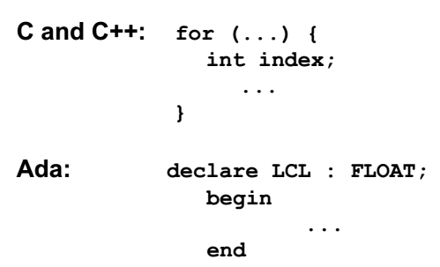
Static Scope
Variables can be hidden from a unit by having a "closer" variable with the same name.
C++ and Ada allow access to these "hidden" variables.
Blocks - a method of creating static scopes inside program units--from ALGOL 60.

Slide 26
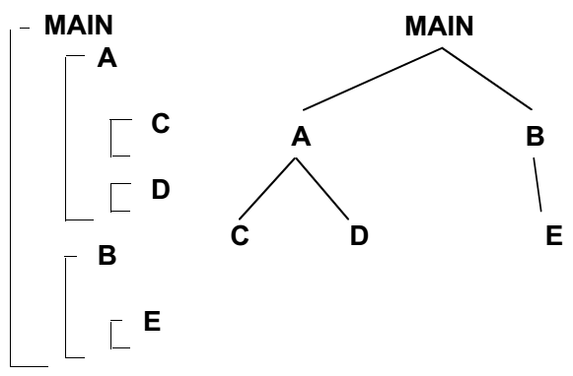
Evaluation of Static Scoping
Consider the example:
Assume MAIN calls A and B
A calls C and D
B calls A and E

Slide 27
Dynamic Scope
Dynamic scoping is based on the calling sequence of subprograms, not on their spatial relationship to each other. Thus, the scope can be determined only at run time.
Based on calling sequences of program units, not their textual layout (temporal versus spatial).
References to variables are connected to declarations by searching back through the chain of subprogram calls that forced execution to this point.

Slide 28
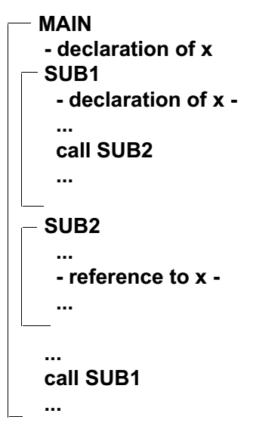
Example:
MAIN calls SUB1
SUB1 calls SUB2
SUB2 uses x
Static scoping - reference to x is to MAIN's x
Dynamic scoping - reference to x is to SUB1's x

Slide 29
Evaluation of Dynamic Scoping
- Advantage: convenience(ease)
Disadvantage: poor readability
Scope and lifetime are sometimes closely related, but are different concepts!!
- Consider a static variable in a C or C++ function.

Slide 30
Referencing Environments
The referencing environment of a statement is the collection of all names that are visible in the statement.
In a static scoped language, that is the local variables plus all of the visible variables in all of the enclosing scopes
A subprogram is active if its execution has begun but has not yet terminated.

Slide 31
Named constant
A named constant is a variable that is bound to a value only when it is bound to storage.
Advantages: readability and modifiability.
The binding of values to named constants can be either static or dynamic.

Slide 32
Variable Initialization
The binding of a variable to a value at the time it is bound to storage is called initialization.
Initialization is often done on the declaration statement.
For example, in C++, we could have:
Int sum = 0;
int* ptrSum = &sum;
Char name[] = "George Washington Carver";

