Slide 1
Agile software development

Slide 2
Agile software development
software development methodologies based on
  iterative and incremental development,
where requirements and solutions evolve through collaboration between
  self-organizing
  cross-functional teams.

Slide 3
Predecessors
heavyweight methods
  heavily regulated, regimented, micromanaged, waterfall model of development
lightweight software development (mid-1990s )
  Scrum (1995),
  Crystal Clear, Extreme Programming (1996),
  Adaptive Software Development, Feature Driven Development,
  Dynamic Systems Development Method (DSDM) (1995).

Slide 4
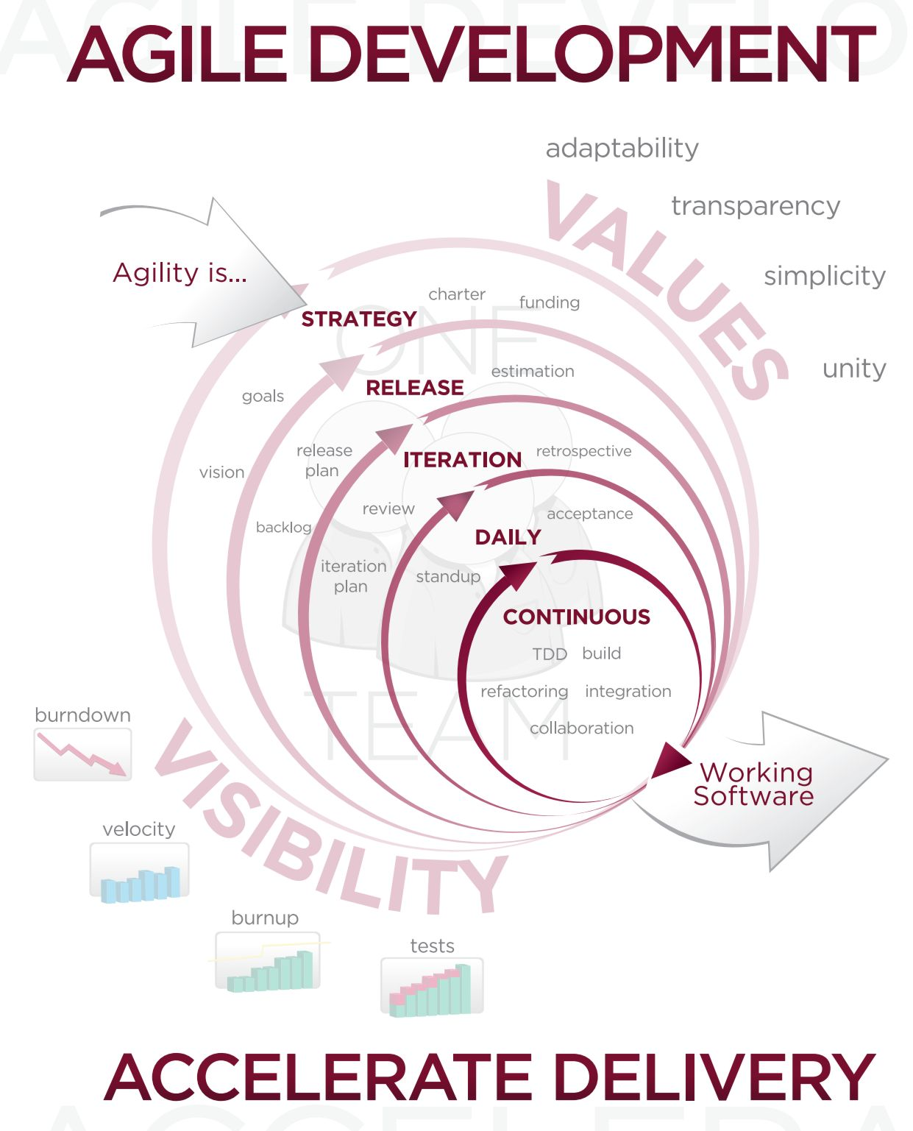

Slide 5
Agile Manifesto
Individuals and interactions over processes and tools
Working software over comprehensive documentation
Customer collaboration over contract negotiation
Responding to change over following a plan

Slide 6
Agile Manifesto - 1
Individuals and Interactions – in agile development, self-organization and motivation are important, as are interactions like co-location and pair programming.
Working software – working software will be more useful and welcome than just presenting documents to clients in meetings.
Customer collaboration – requirements cannot be fully collected at the beginning of the software development cycle, therefore continuous customer or stakeholder involvement is very important.
Responding to change – agile development is focused on quick responses to change and continuous development.

Slide 7
Agile Manifesto - Twelve principles
Customer satisfaction by rapid delivery of useful software
Welcome changing requirements, even late in development
Working software is delivered frequently (weeks rather than months)
Working software is the principal measure of progress
Sustainable development, able to maintain a constant pace
Close, daily co-operation between business people and developers

Slide 8
Agile Manifesto - Twelve principles -II
Face-to-face conversation is the best form of communication (co-location)
Projects are built around motivated individuals, who should be trusted
Continuous attention to technical excellence and good design
Simplicity
Self-organizing teams
Regular adaptation to changing circumstances

Slide 9
Agile Model Driven Development (AMDD)
MDD-approach to software development where extensive models are created before source code is written.
AMDD - small, co-located team

Slide 10
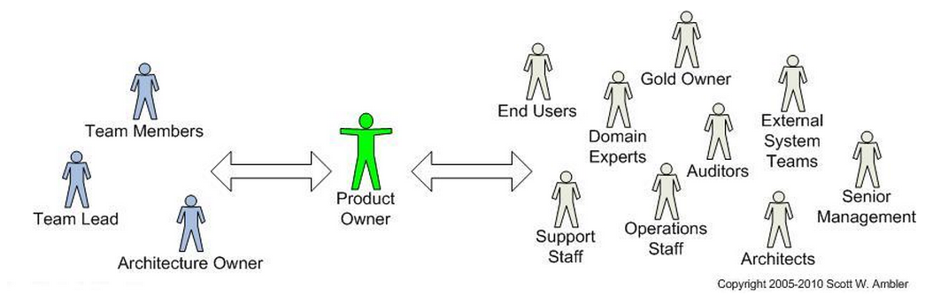
You'll work with a range of stakeholders

Slide 11
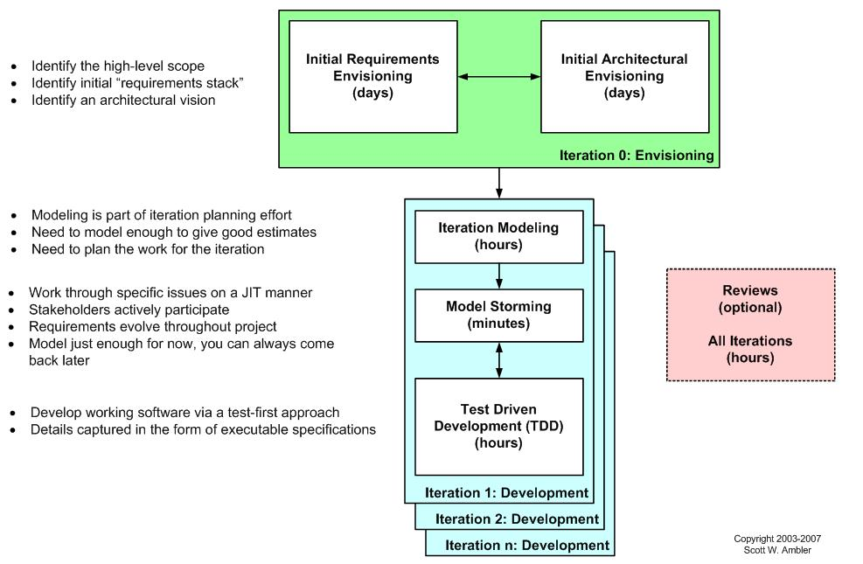
AMDD lifecycle: Modeling activities in SDLC

Slide 12
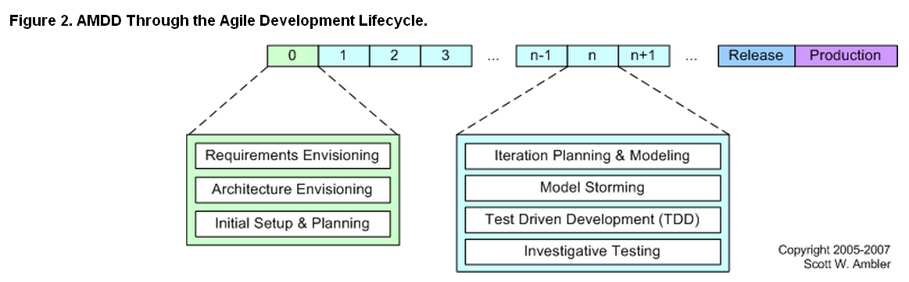
AMDD Through the Agile Development Lifecycle.

Slide 13
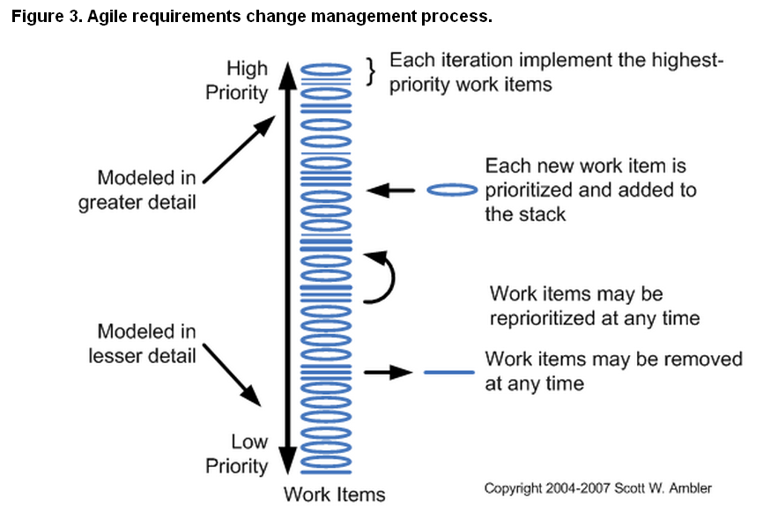
Agile requirements change management process

Slide 14
Why Should You Do Some Initial Agile Requirements Envisioning?
You can answer fundamental business questions.
  Like it or not, people are always going to ask you:
    what the vision
    what's the scope
    how long do you think it's going to take (the schedule)
    how much is it going to cost (the expected budget).
      You often don't need to answer these questions in detail but you will need to convince the people who are funding and supporting your project that you understand the fundamental business issues that your project team is going to address.
Improved productivity.
  You can identify and think through some of the critical business issues facing your project.

Slide 15
Why Should You Do Some Initial Agile Requirements Envisioning? - II
Big Requirements Up Front (BRUF) Approach
Reduced business risk.
  Your team gains the advantage of having a guiding business vision without the disadvantages associated with BRUF.
Scaling agile software development.
  Your initial requirements model will be a key work product in any "agile at scale" efforts because it provides the business direction required by your overall architecture team for their initial architectural envisioning efforts

Slide 16
What Should You Model Initially?
identify some high-level requirements as well as the scope of the release
The goal is to get a good gut feel what the project is all about.
Go on:
  Usage model
  Domain model
  User interface model(s)

Slide 17
Usage Model
Usage models enable you to explore:
  how users will work with your system
  collection of essential use cases or system use caseson a Rational Unified Process (RUP) project
  a collection of features for a Feature Driven Development (FDD) project
  a collection of user stories for an Extreme Programming (XP) project.

Slide 18
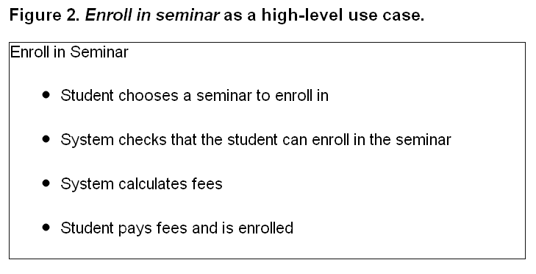
Usage Model - II

Slide 19
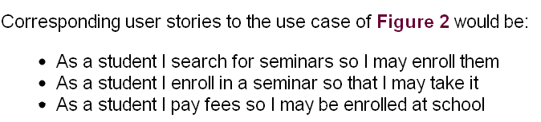
Usage Model - III

Slide 20
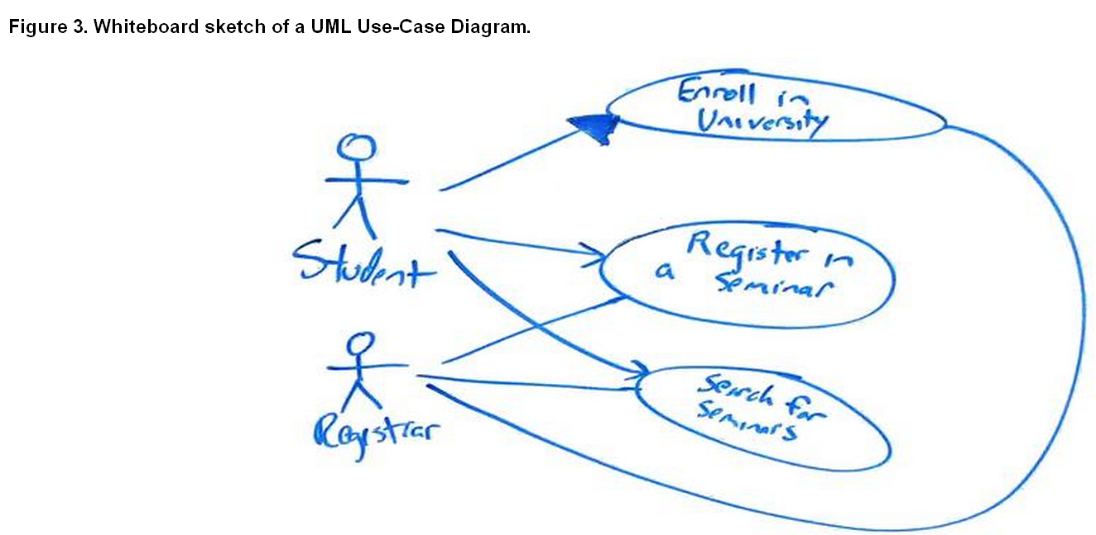
Usage Model - IV

Slide 21
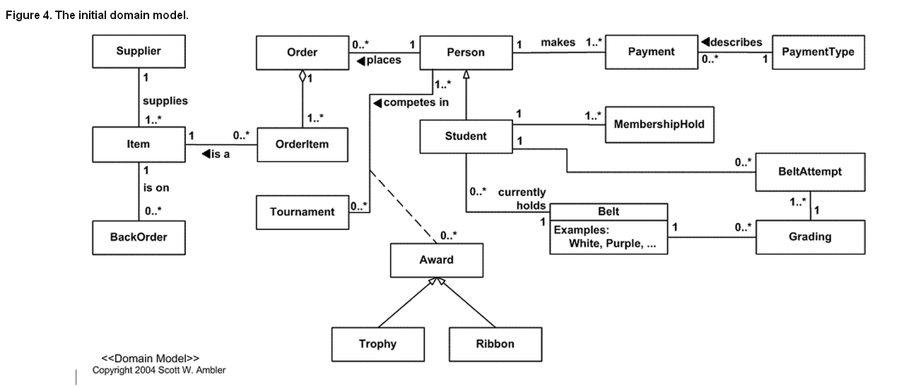
Domain Model

Slide 22
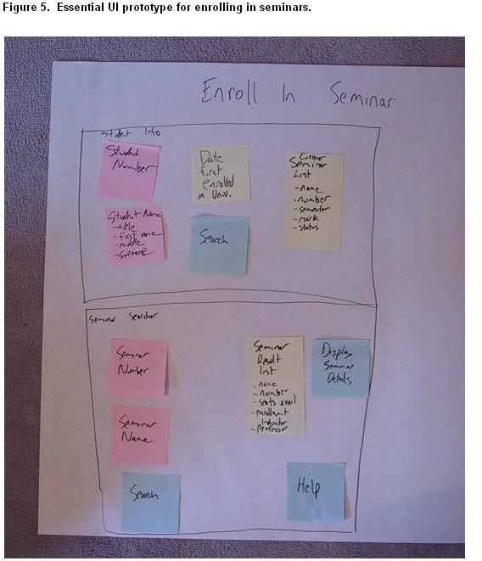
User Interface Model

Slide 23
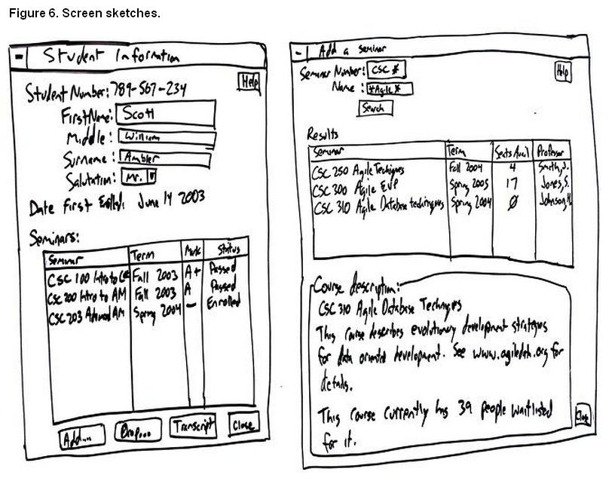
User Interface Model

Slide 24
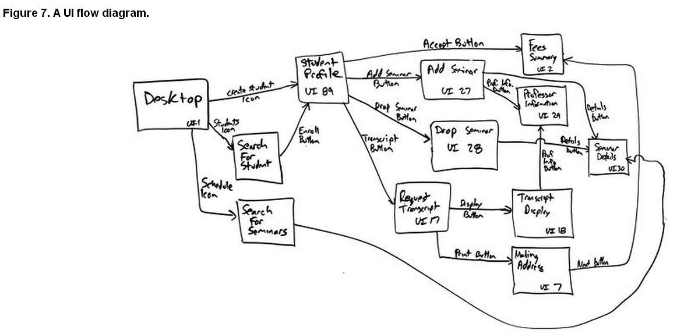
User Interface Model

Slide 25
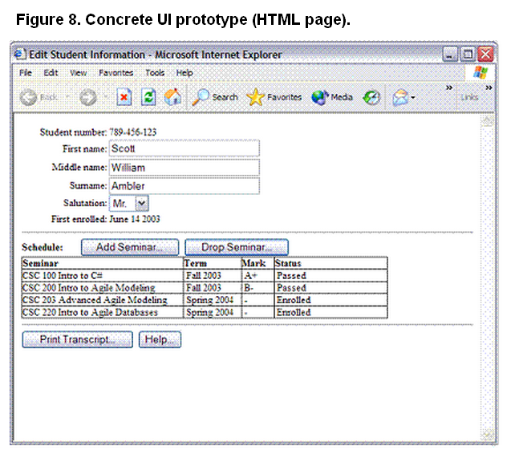
User Interface Model

Slide 26
What Modeling Tools Should You Use?

Slide 27
How Much Initial Requirements Envisioning Should You Do?
Initial requirements stack.
  prioritized requirements stack
Initial project vision.
  To reduce your overall business risk on the
  Rational Unified Process (RUP)
  Project Management Institute (PMI)
Overview diagrams.
  Because you’ll likely need to give presentations to key project stakeholders overviewing the project you’ll likely want to create a couple of scope diagrams which describe the business.
  UML use case diagrams or traditional business process models are usually pretty good at this.

Slide 28
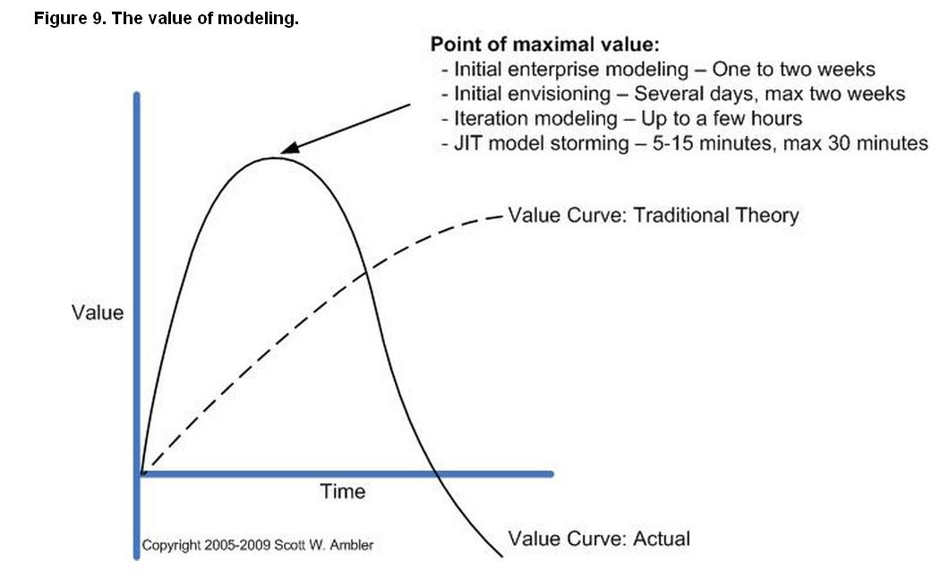
The value of modeling

Slide 29
Why You Don't Need, Nor Want, Details Up Front
It results in significant wastage.
It decreases the chance that you'll detect that you're building the wrong thing.
People aren't good at defining up front what they want.
It motivates poor decision making.
It increases communication risk.

Slide 30
Why You Don't Need, Nor Want, Details Up Front - II
Many traditionalists will tell you that you need to model everything up front in detail. They mistakenly believe this for several reasons:
  That's what they know. Big modeling up front (BMUF)
  They're specialists
  Traditional project management ideas motivate poor modeling strategies.
  They underestimate their own scheduling skills.
  They've given up hope.

Slide 31
When Does it Make Sense to do a lot of Requirements Envisioning?
You're working in an unknown problem space.
You're working on a commercial product.
Your governance framework is serial.
You're doing systems engineering.
Your contract demands it.
Your organizational culture promotes it.

Slide 32
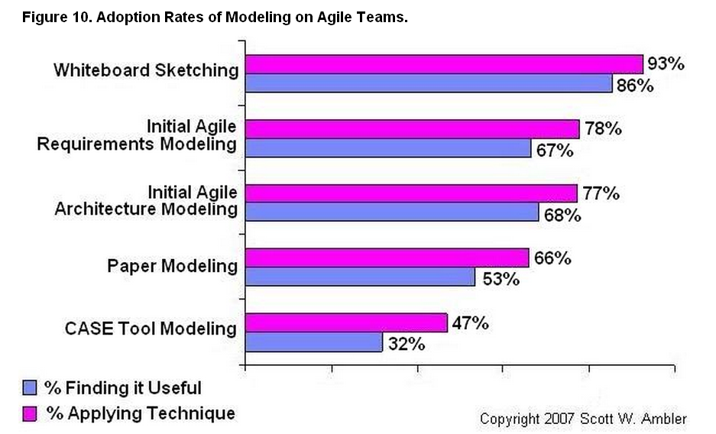
Are People Actually Doing This?

Slide 33
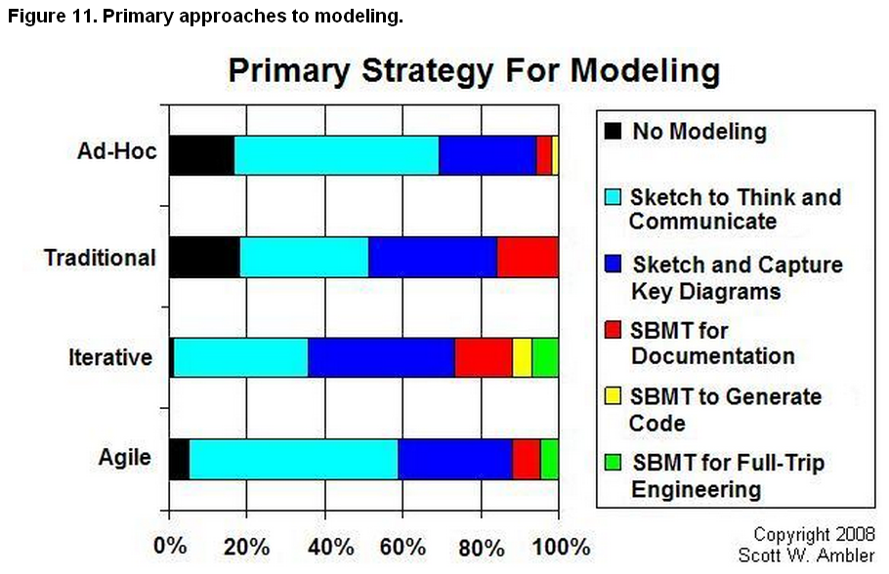
Primary approaches to modeling.

Slide 34
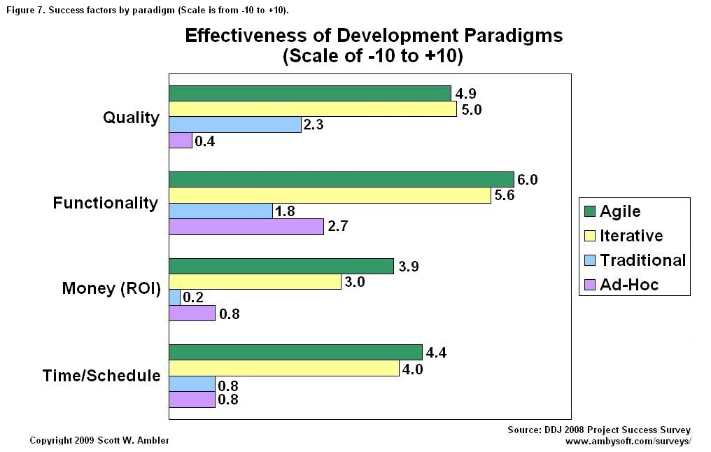
Success factors by paradigm

Slide 35
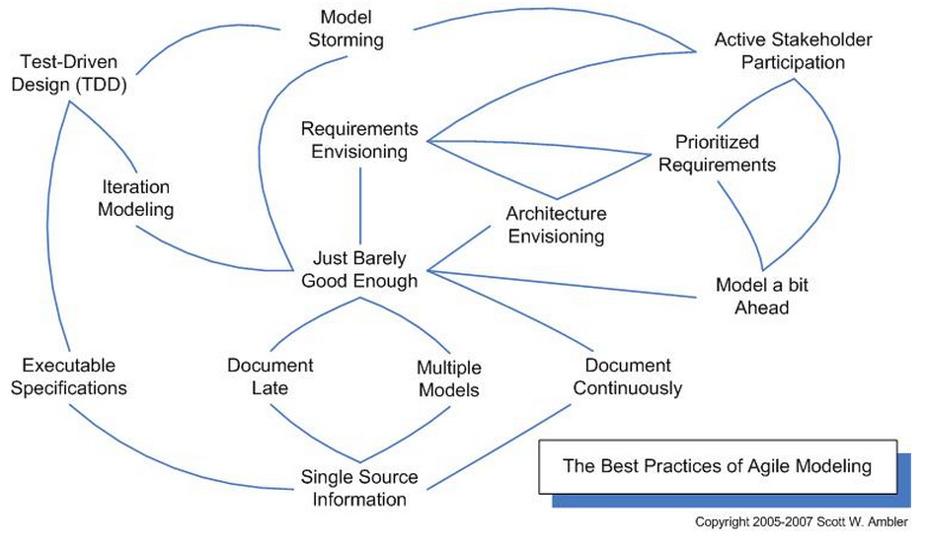
The best practices of Agile Modeling.

Slide 36
SCRUM

Slide 37
Intro
iterative, incremental framework for project management
contains sets of practices and predefined roles:
  the “ScrumMaster”, who maintains the processes
  the “Product Owner”, who represents the stakeholders and the business
  the “Team”, a cross-functional group of about 7 people who do the actual analysis, design, implementation, testing, etc.

Slide 38
Scrum Roles
Ancillary Scrum roles
The ancillary(additional) roles in Scrum teams are those with no formal role and infrequent involvement in the Scrum process—and must nonetheless be taken into account.
  Users
  The software is being built for someone! If software is not used - much like 'the tree falling in a forest' riddle - was it ever written?
  Stakeholders (customers, vendors)
  The people that will enable the project, but are only directly involved in the process at sprint reviews.
  Managers
  People that will set up the environment for the product development organization.

Slide 39
Scrum Roles
Core Scrum roles
The core roles in Scrum teams are those committed to the project in the Scrum process—they are the ones producing the product (objective of the project).
Product Owner
  represents the voice of the customer and is accountable for ensuring that the Team delivers value to the business.
  writes customer-centric items (typically user stories), prioritizes them, and adds them to the product backlog(access). Scrum teams should have one Product Owner, and while they may also be a member of the Development Team, it is recommended that this role not be combined with that of ScrumMaster.

Slide 40
Scrum Roles
Team
  The Team is responsible for delivering the product.
  5–9 people with cross-functional skills who do the actual work (analyse, design, develop, test, technical communication, document, etc.). It is recommended that the Team be self-organizing and self-led, but often work with some form of project or team management.
ScrumMaster
  who is accountable for removing impediments(hurdles) to the ability of the team to deliver the sprint goal/deliverables.
  not the team leader but acts as a buffer between the team and any distracting influences.
  ensures that the Scrum process is used as intended.
  enforcer of rules.

Slide 41
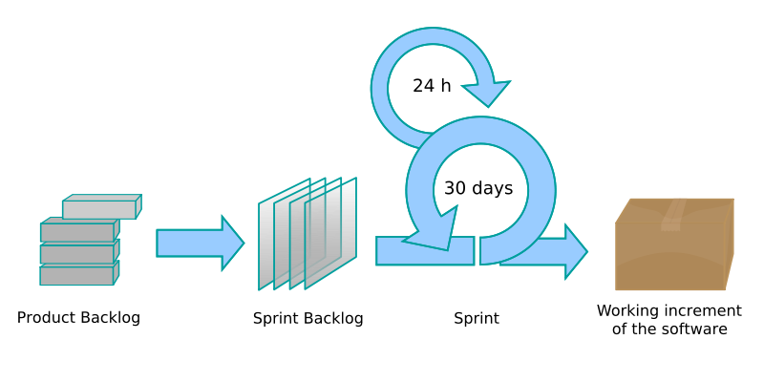
Scrum process flow

Slide 42
Scrum process flow
Planning
Product owner and team decide which stories are actually feasible to be moved from the Product backlog to the Sprint backlog.
Sprint
The team is left alone to perform the user stories which it has committed itself in the planning meeting. The product owner may attend the “daily scrums” if a granular status update is desired.
Review
The team presents its work and verifies what it has done indeed satisfies the utmost desires of the product owner.

