Slide 1
Chapter 8
Statement-Level Control Structure

Slide 2
Introduction
Levels of Control Flow:
1. Within expressions
2. Among program units
3. Among program statements.
A control structure is a control statement and the collection of statements whose execution it controls.

Slide 3
Selection Statements
A selection statement provides the means of choosing between two or more execution paths in a program.
Design Issues:
What is the form and type of the control expression?
What is the selectable segment form (single statement, statement sequence, compound statement)?
How should the meaning of nested selectors be specified?

Slide 4
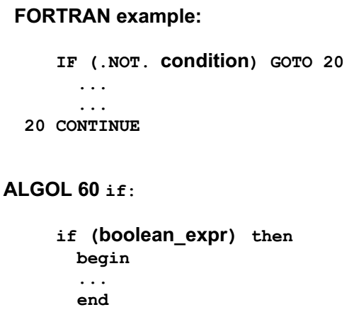
Single-Way Examples
FORTRAN IF: IF (boolean_expr) statement
Problem: can select only a single statement; to
select more, a goto must be used, as in the
following example

Slide 5
Two-Way Selection Statements
Although the two-way selection statements of contemporary imperative languages are quite similar, there are some variations in their designs. The general form of a two-way selector is as follows:
if control_expression
then clause
else clause

Slide 6
Design Issues:
The design issues for two-way selectors can be summarized as follows:
• What is the form and type of the expression that controls the selection?
• How are the then and else clauses specified?
• How should the meaning of nested selectors be specified?

Slide 7
Two-way Selector Examples
ALGOL 60 if:
if (boolean_expr)
then statement (the then clause)
else statement (the else clause)
- The statements could be single or compound

Slide 8
Nesting Selectors
e.g. (Pascal) if ... then
if ... then
...
else ...
Which then gets the else?
Pascal's rule: else goes with the nearest then.

Slide 9
Selector Expressions
In the functional languages ML, F#, and LISP, the selector is not a statement; it is an expression that results in a value. Therefore, it can appear anywhere any other expression can appear. Consider the following example selector written in F#:
Let y =
if x > 0 then x
else 2 * x;;
This creates the name y and sets it to either xor 2 * x, depending on whether x is greater than zero.

Slide 10
Multiple-Selection Statements
The multiple-selectionstatement allows the selection of one of any number of statements or statement groups. It is, therefore, a generalization of a selector. In fact, two-way selectors can be built with a multiple selector.
Design Issues:
1. What is the form and type of the control
expression?
2. What segments are selectable (single,
compound, sequential)?

Slide 11
Design Issues
3. Is the entire construct encapsulated?
4. Is execution flow through the structure restricted to include just a single selectable segment?
5. What is done about unrepresented expression
values?

Slide 12
Consider the following example:
Switch (index) {
case 1:
case 3: odd += 1;
sumodd += index;
case 2:
case 4: even += 1;
sumeven += index;
default : printf("Error in switch, index = %d\n", index);
}
This code prints the error message on every execution.

Slide 13
Iterative Statements
An iterative statement is one that causes a statement or collection of statements to be executed zero, one, or more times. An iterative statement is often called a loop.
General design Issues for iteration control
statements:
1. How is iteration controlled?
2. Where is the control mechanism in the loop?

Slide 14
Counter-Controlled Loops
A counting iterative control statement has a variable, called the loop variable, in which the count value is maintained. It also includes some means of specifying the initial and terminal values of the loop variable, and the difference between sequential loop variable values, often called the step size. The initial, terminal, and step size specifications of a loop are called the loop
parameters.

Slide 15
Design Issues:
1. What is the type and scope of the loop var?
2. What is the value of the loop var at loop
termination?
3. Should it be legal for the loop var or loop
parameters to be changed in the loop body,
and if so, does the change affect loop control?
4. Should the loop parameters be evaluated only once, or once for every iteration?
The general form of C’s for statement is
for (expression_1; expression_2; expression_3)
loop body
The loop body can be a single statement, a compound statement, or a null statement.

Slide 16
Unconditional Branching
An unconditional branch statement transfers execution control to a specified location in the program.
Problem: readability.
Some languages do not have them:e.g., Modula-2 and Java
e.g. goto statement.

